Slide 1
Introduction to Trees and Graphs
</
/>
Any title here

Slide 2
</Agenda
Introduction to Trees and Graphs
Key Definitions in Graph Theory
Types of Trees
Types of Graphs
Graph Representations
Basic Operations on Graphs
Traversal Algorithms

Slide 3
</Key Definitions in Graph Theory
Graphs: A graph data structure is a collection of nodes (also called vertices) and edges that connect them. Nodes can represent entities, such as people, places, or things, while edges represent relationships between those entities.
Directed vs. Undirected Graphs: Directed graphs have edges with a direction, while undirected graphs have edges that indicate a bidirectional relationship.
Weighted vs. Unweighted Graphs: Weighted graphs assign values to edges, representing costs or distances, while unweighted graphs treat all edges equally for traversal.

Slide 4
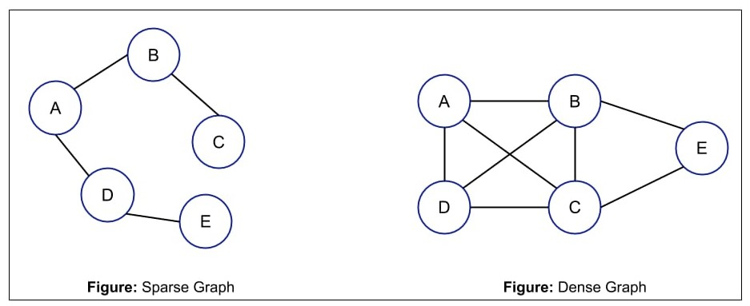
</Key Definitions in Graph Theory
Sparse vs. dense Graphs:
sparse → n edges → adjacency lists
dense → n^2 edges → adjacency matrix

Slide 5
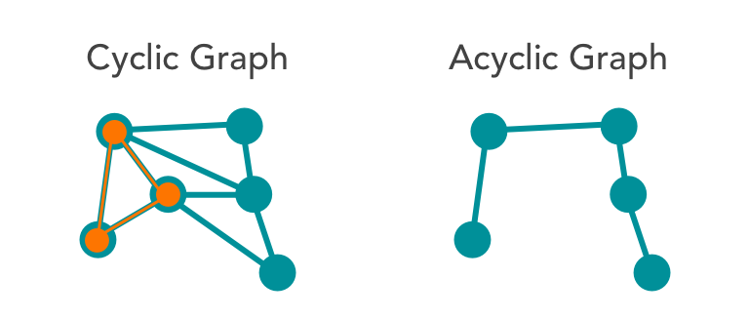
</Key Definitions in Graph Theory
cyclic vs. acyclic Graphs:

Slide 6
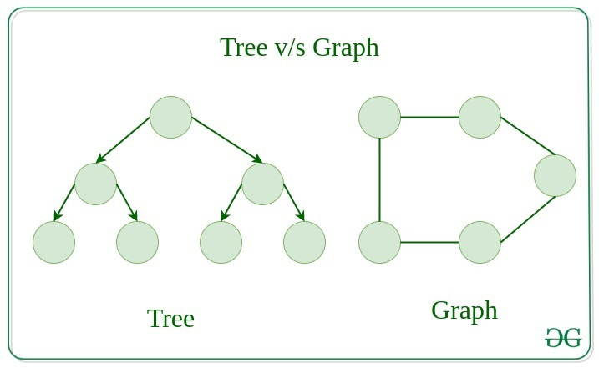
</trees VS graphs

Slide 7
</trees VS graphs
What is Tree?
A tree data structure is a hierarchical data structure that consists of nodes connected by edges. Each node can have multiple child nodes, but only one parent node. The topmost node in the tree is called the root node.

Slide 8
 | graphs | trees
A collection of nodes (vertices) and edges, where edges connect nodes.
A hierarchical data structure consisting of nodes connected by edges with a single root node.
Definition
Can have cycles (loops) and disconnected components.
No cycles; connected structure with exactly one path between any two nodes.
Structure
No root node; nodes may have multiple parents or no parents at all.
Has a designated root node that has no parent.
Root Node
Edges
Each node can have any number of edges.
If there is n nodes then there would be n-1 number of edges

Slide 9
</types of tree
Binary Trees: Each node has at most two children, providing a streamlined structure for search algorithms and hierarchical data.
AVL Trees: A self-balancing binary tree, ensuring heights of subtrees differ by at most one to maintain efficient operations.
Red-Black Trees: A balanced tree structure that maintains specific properties to ensure O(log n) time complexity for insertions and deletions.

Slide 10
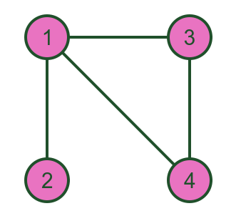
</types of graphs
Simple Graphs : Graphs without loops or multiple edges between the same vertex pairs, essential for maintaining clarity in relationships.

Slide 11
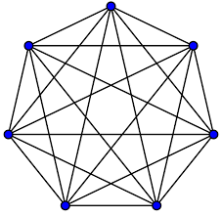
</types of graphs
Complete Graphs : Every pair of distinct vertices is connected by a unique edge, maximizing connectivity and minimizing distance in modeling relationships.

Slide 12
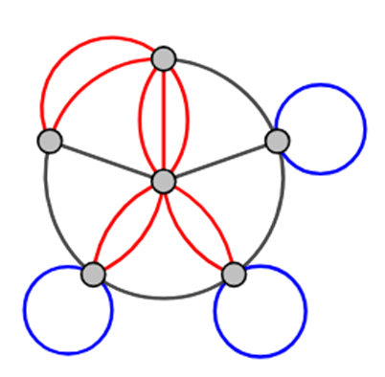
</types of graphs
Multigraphs : Graphs that allow multiple edges between vertices, accommodating complex relationships often seen in network applications.

Slide 13
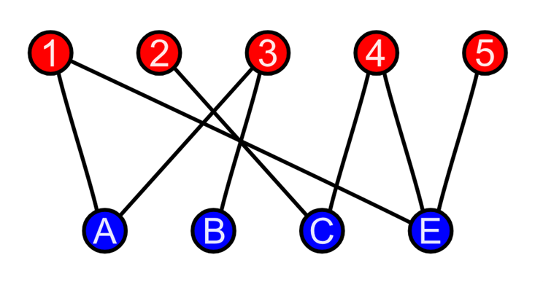
</types of graphs
Bipartite Graphs : A graph whose vertices can be divided into two disjoint sets where edges only connect vertices from different sets, commonly utilized in matching problems.

Slide 14
</Graphs traverse

Slide 15
Thank you !
</
/>
Any Questions?

